Slide 1


Implementation of the SBDART model for the estimation of the aerosol radiative forcing
Fernando Londoño Palacio
Tutor: Elena Montilla Rosero
First Advance
Advanced Project I
Engineering Physics
School of Applied Science and Engineering
Vigilada Mineducación

Slide 2

CONTENT
1
6
Problem definition and objetives
SBDART flux diagram
2
7
Inputs of the program
Radiometric quantities
3
8
Schedule of actitvities
Description of radiative transfer
9
Next steps
4
Radiative transfer equation (general form)
10
References
5
RT in a plane parallel atmosphere
Vigilada Mineducación

Slide 3
3
Problem definition and objetives
Problem?
General: Estimate the radiative forcing due to atmospheric aerosols in the Aburrá Valley by implementing the SBDART model.
Available models to simulate atmospheric radiative transfer:
DART.
libRadtran.
SBDART.
LOWTRAN 7.
Specifics:
Understand the fundamentals of the physical-mathematical model implemented in the SBDART radiative transfer model.
Determine the physical and optical properties of the atmospheric aerosols involved in the SBDART model based on the bibliographic review of the available literature.
Implement the SBDART model using locally available information.
Would the application of the SBDART model considering the optical and physical properties of local aerosols allow us to know the radiative forcing due to these particles in the Aburrá Valley?
Objetives

Slide 4
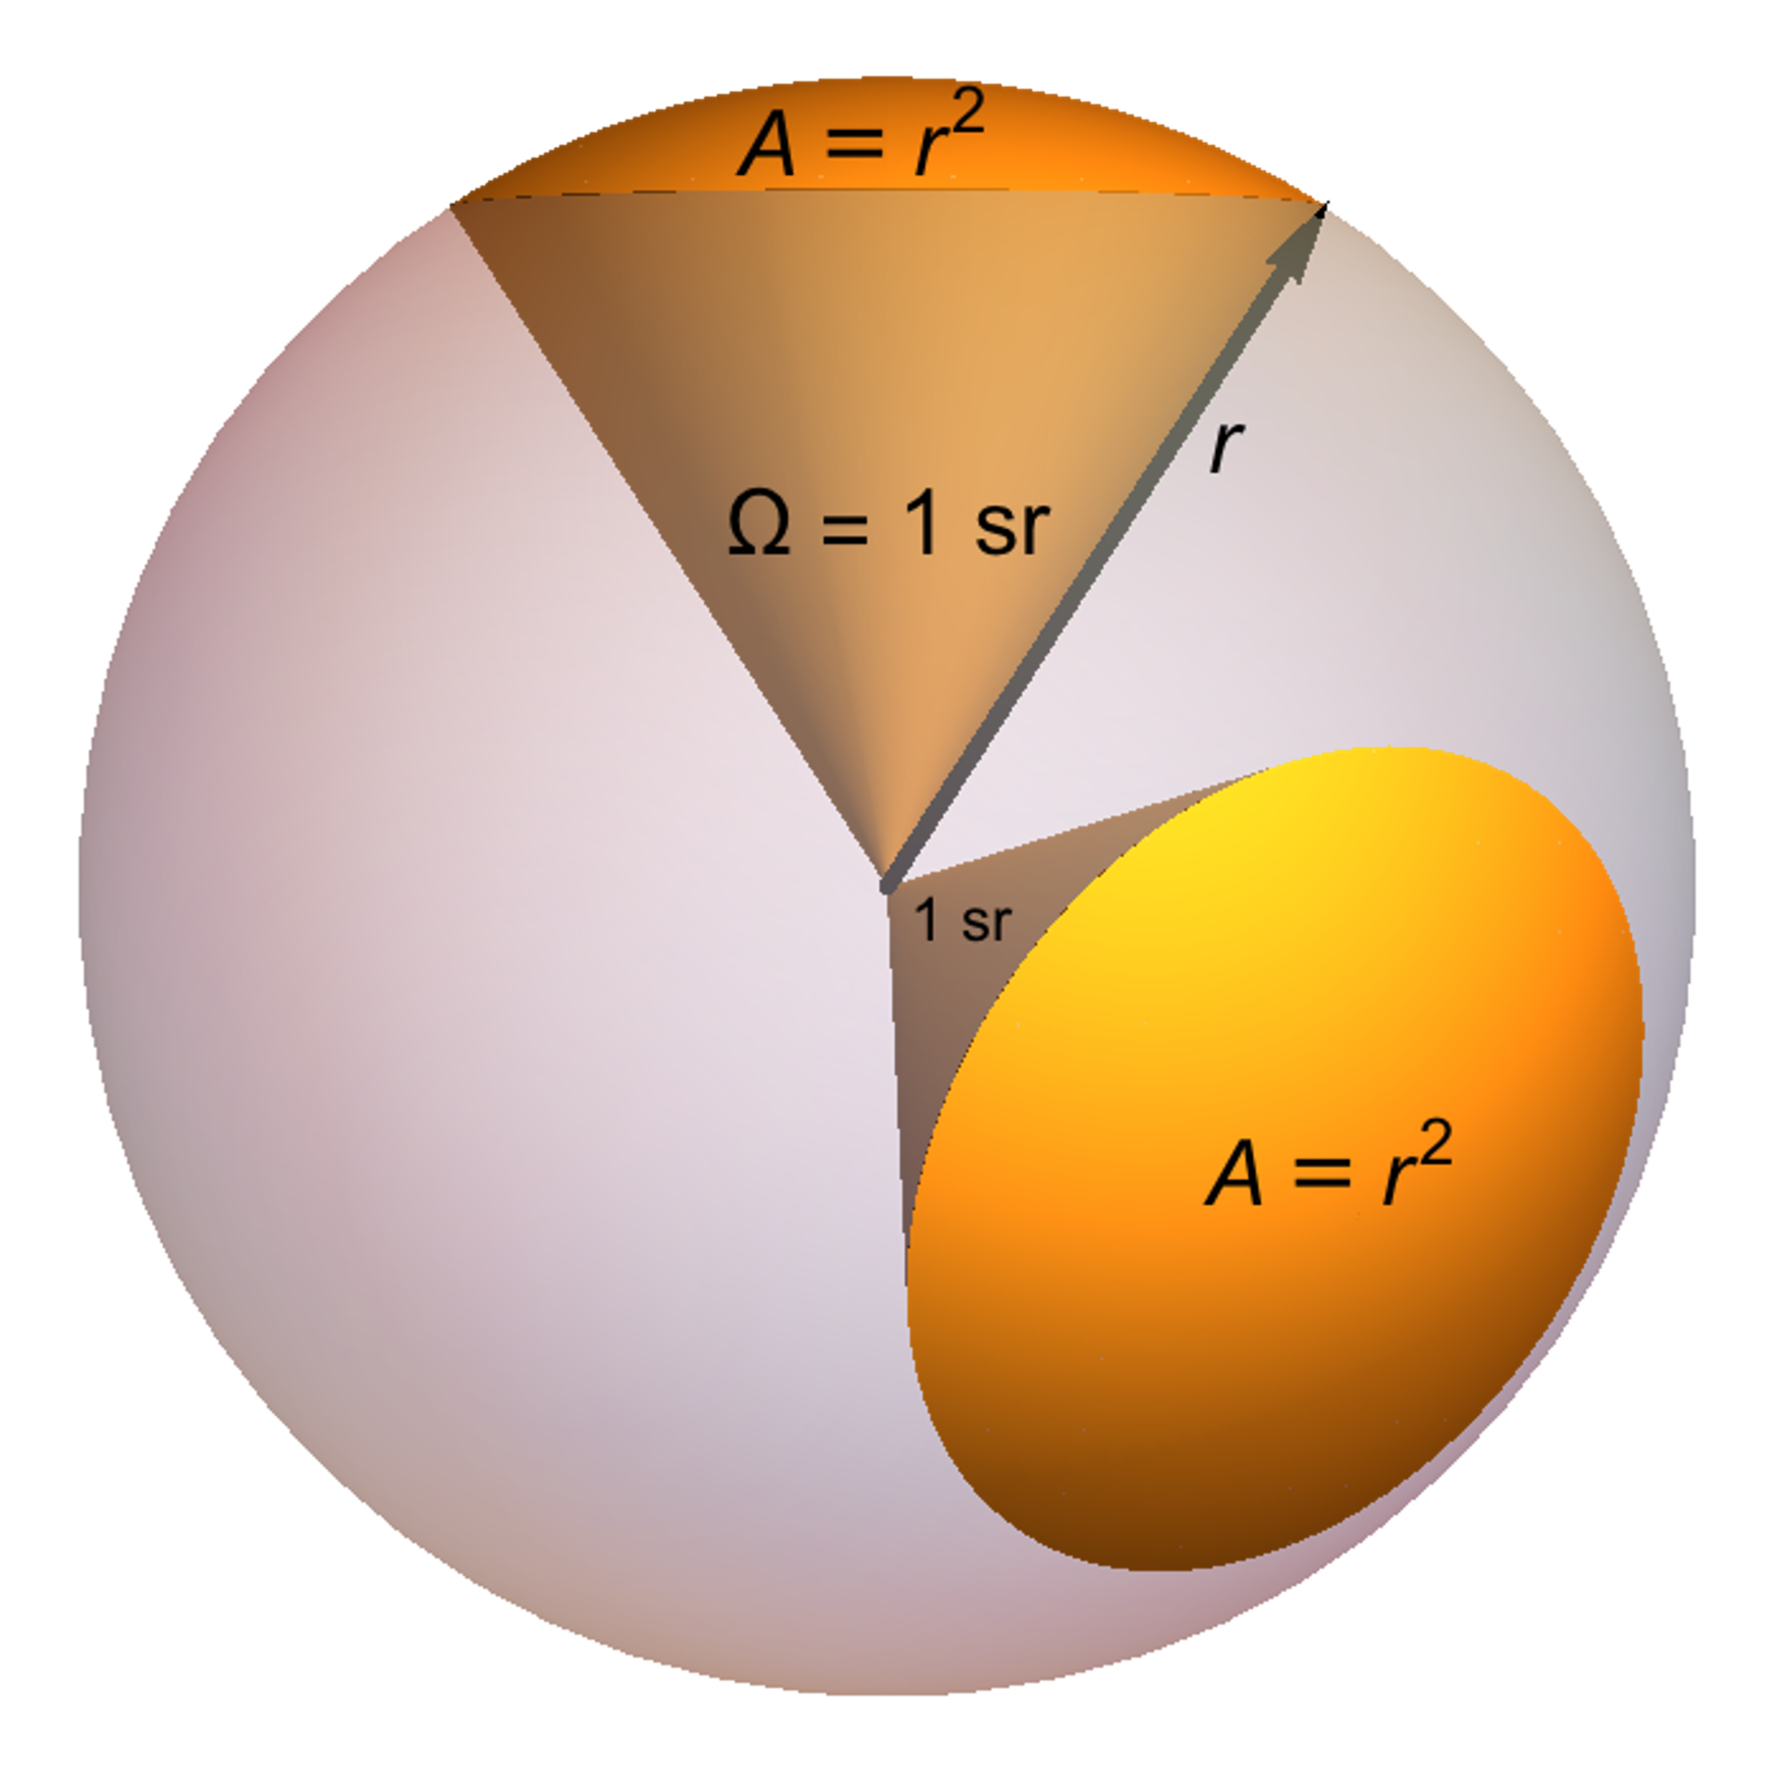
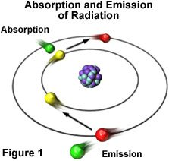
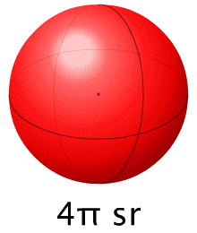
4
Description of radiative transfer
Radiative Transfer
Radiometric Quantities
Note: The notation with subscript λ means that is a quantitie determined for a single wavelenght.
Radiant Energy [J]
Radiance [W/(m^2*sr)]
Irradiance [W/m^2* λ]
Energy Flux [W/m^2]
The radiative transfer or radiative transport is the physical phenomenon of energy transfer in form of electromagnetic radiation.
Taken: [1], [2]

Slide 5
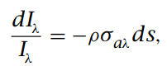
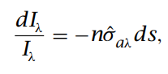
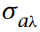
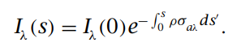
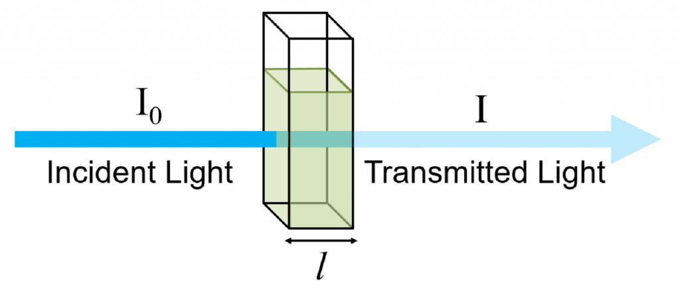
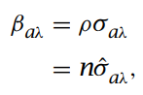
5
Description of radiative transfer
Absorption
Beer-Lambert Law
Integrating along the path of radiation:
Wich allow us to introduce the absorption coefficient:
The absorption, in abscense of scattering is determined by the Beer-Lambert Law.
“The fractional energy absorbed from a pencil of radiation is proportional to the mass traversed by the radiation” [1]
Where is the absorption cross section.
Taken: [3], [4]

Slide 6
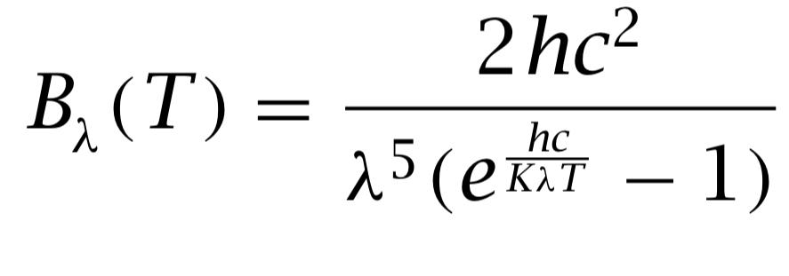
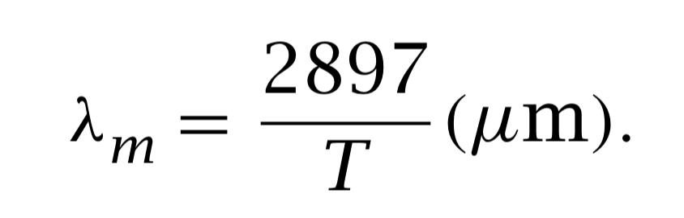
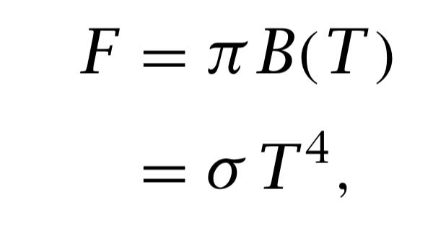
6
Description of radiative transfer
Emission
Black body
Plank´s Law:
Wiens´s Displacement Law:
Stefan-Boltzman Law:
In order to maintain the thermal equilibrium, a substance that absorbs radiant energy must also emit it.
In thermal equilibrium the radiation emitted follows the properties:
The radiation depends by the temperature of the emitter.
Radiant energy is the maximum possible at all wavelengths.
The radiation is isotropic.
Taken: [3]

Slide 7
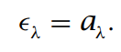
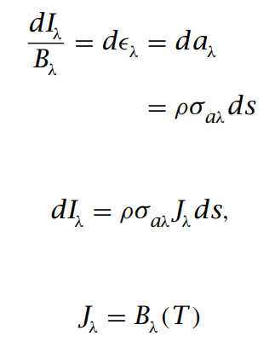
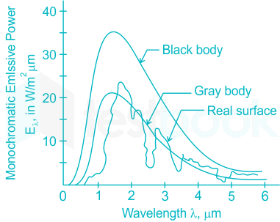
7
Description of radiative transfer
Gray body
Kirchoff´s law
Kirchoff´s law:
Fracctional energy emitted:
From Beer-Lambert law:
Monochromatic source function:
A gray body has a different behavior than a black body since its emissivity and absorptivity are different from 1.
For a gray body in equilibrium the emissivity and absorptivity must be equal and that leads to the Kirchoff´s law.
Taken: [3], [4]

Slide 8
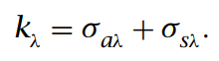
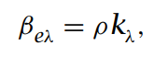
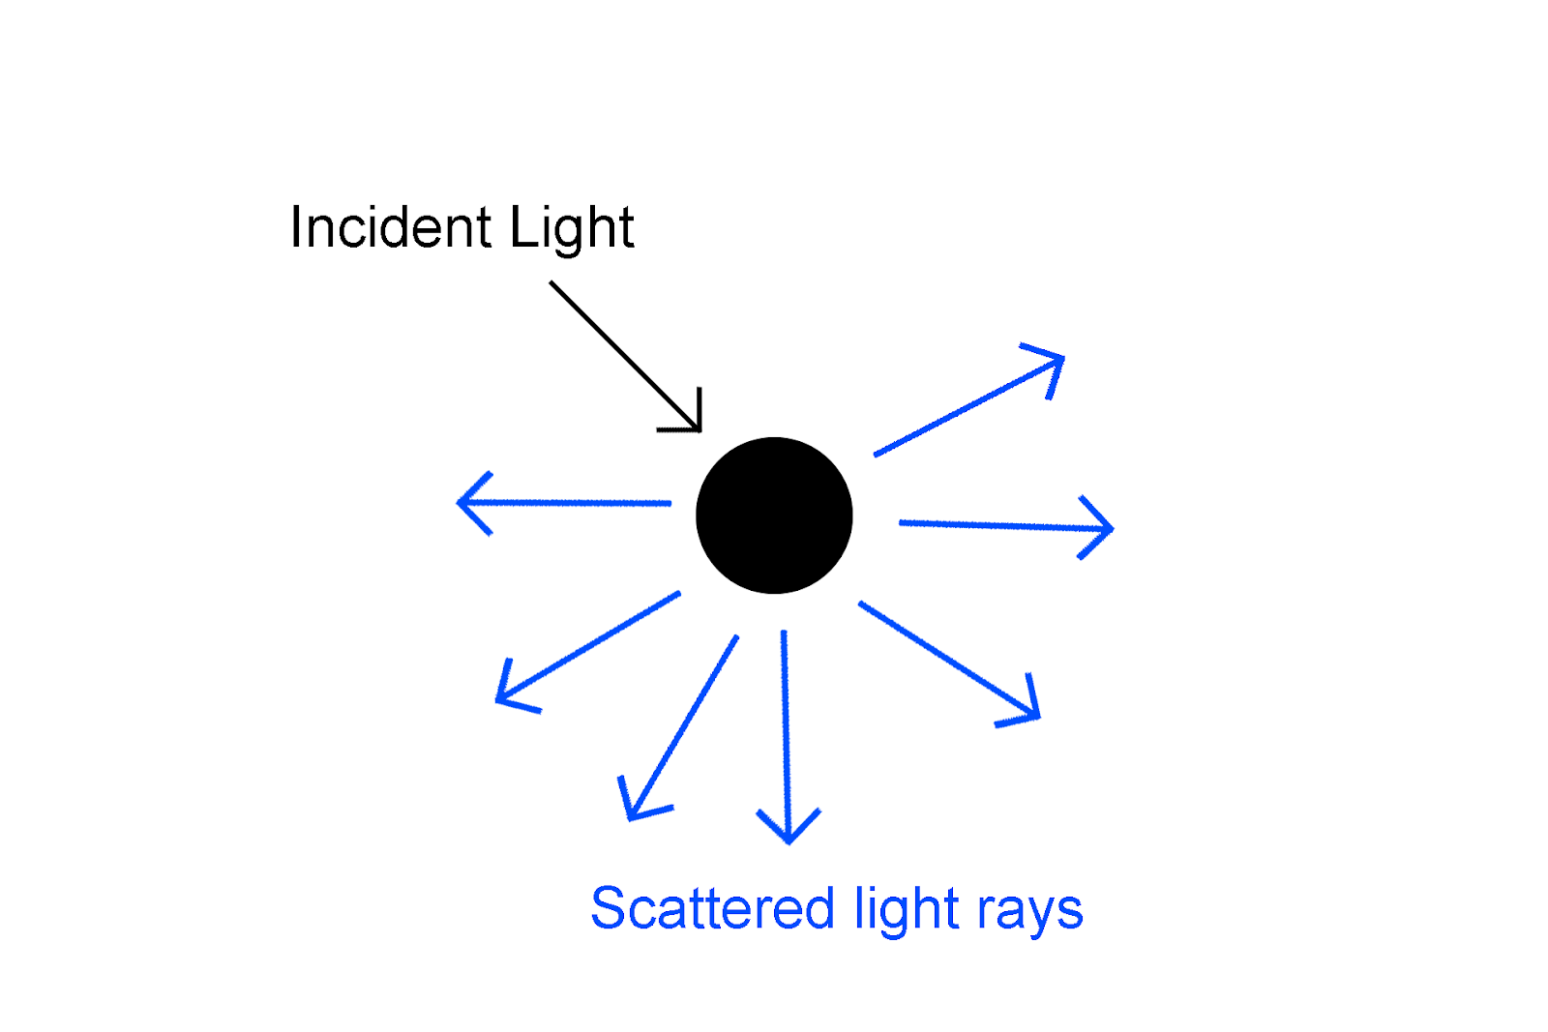
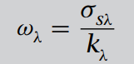
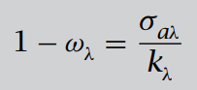
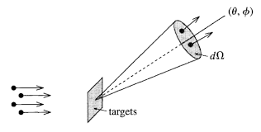
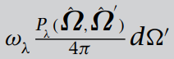
8
Description of radiative transfer
Scattering
Due to absorption and scattering are linear with the irradiance we can define the extinction cross section as:
And the extinction coefficient:
And the Single Scattering Albedo represents the fracction of radiation lost through extinction that is scattered out of the solid angle:
Then, the fracction of radiation lost through absorption:
The phase funtion represents the fracction of radiation lost through extinction away from the solid angle to a new solid angle:
The scattering is the process of extraction and re-emission of energy by matter.
Taken: [3], [7]

Slide 9
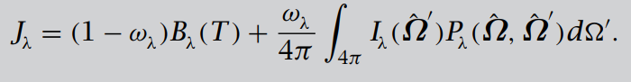
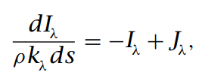
9
Radiative transfer equation
Combining the contribution of the emission and scattering leads us to the total source function:
In general form, the radiative transfer equation collecting the extinction energy and the introduction of energy yields the net rate at which intensity inside a solid angle changes in the s direction:
General form
Taken: [3]

Slide 10
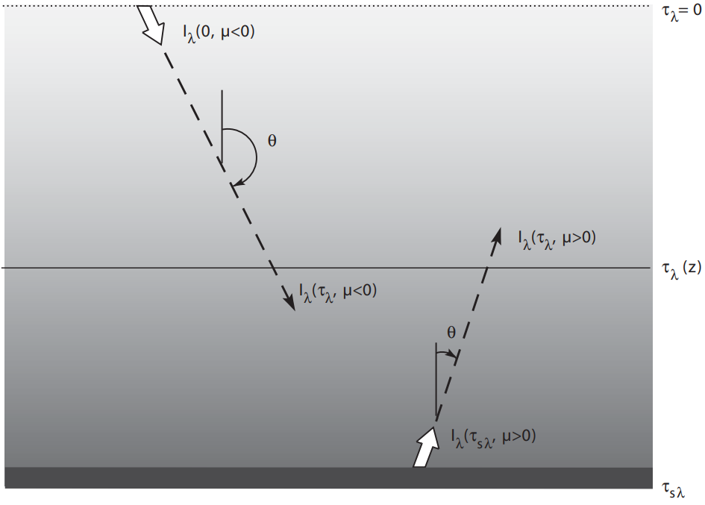
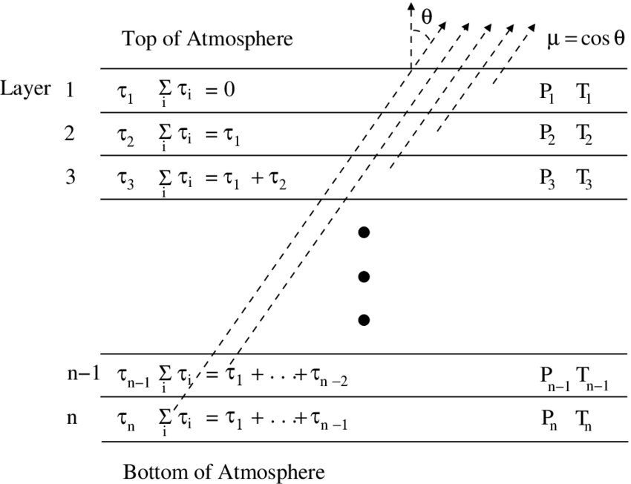
10
RT in a plane parallel atmosphere
Atmospheric radiative transfer is usually simplified by modeling a plane parallel atmosphere.
Taken: [3], [8]

Slide 11
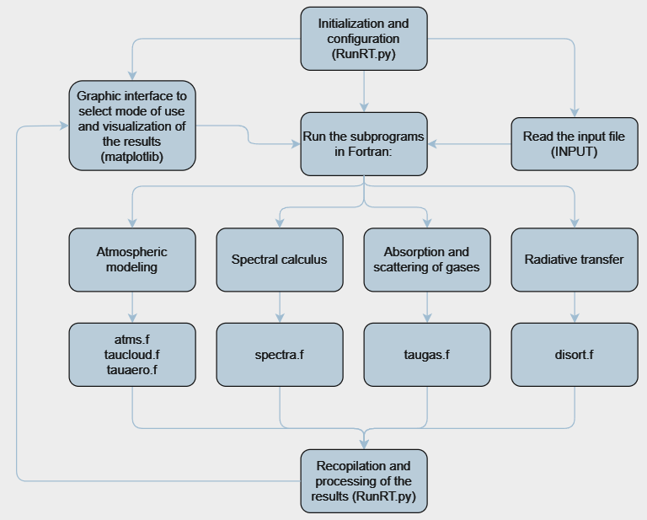
11
SBDART flux diagram
Own Elaboration.

Slide 12
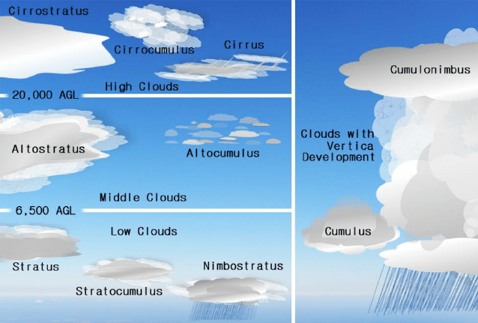
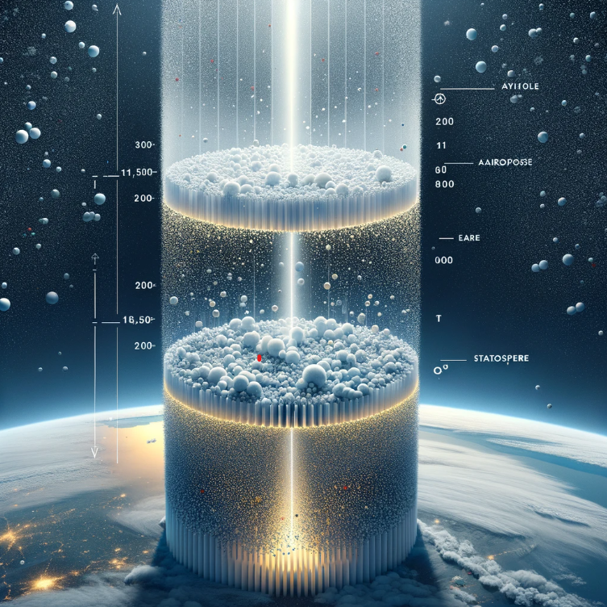

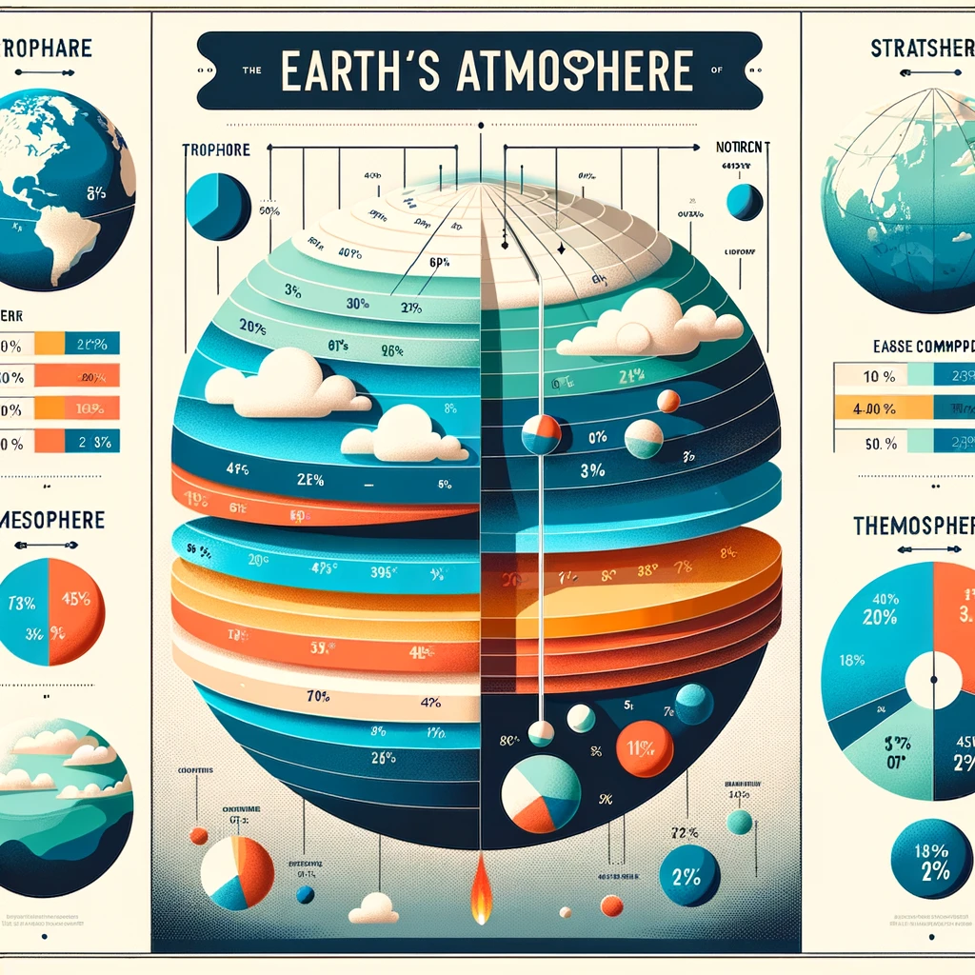
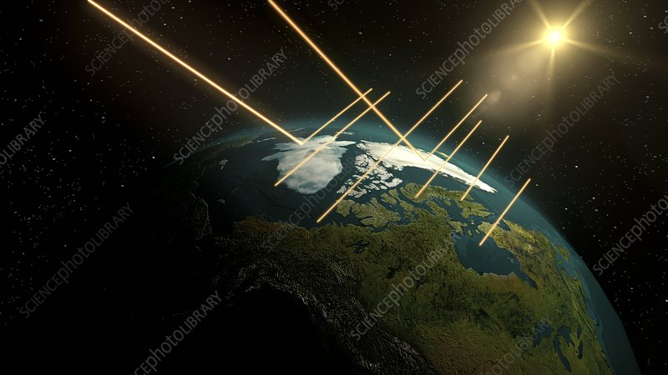
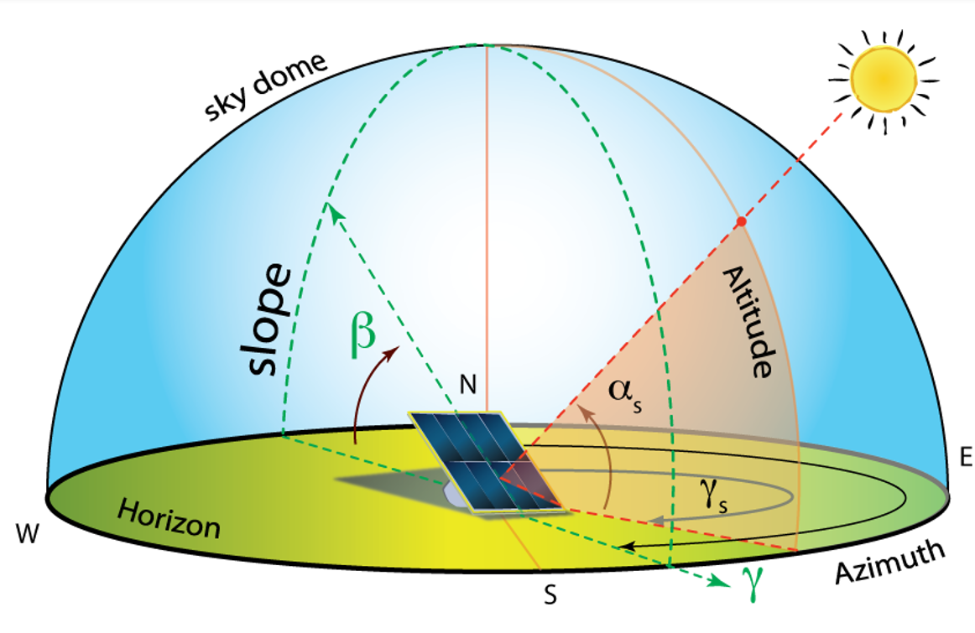
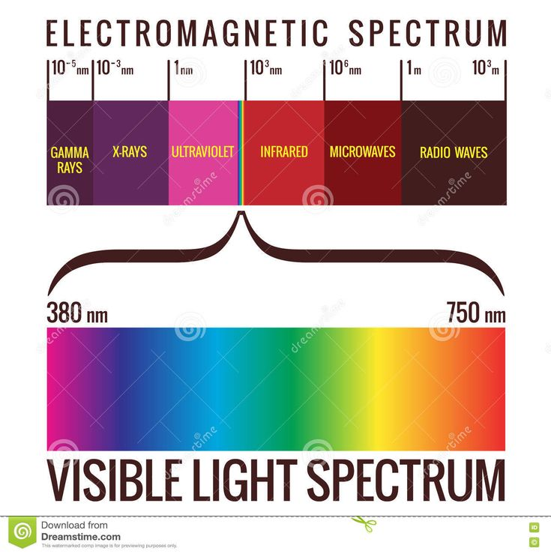
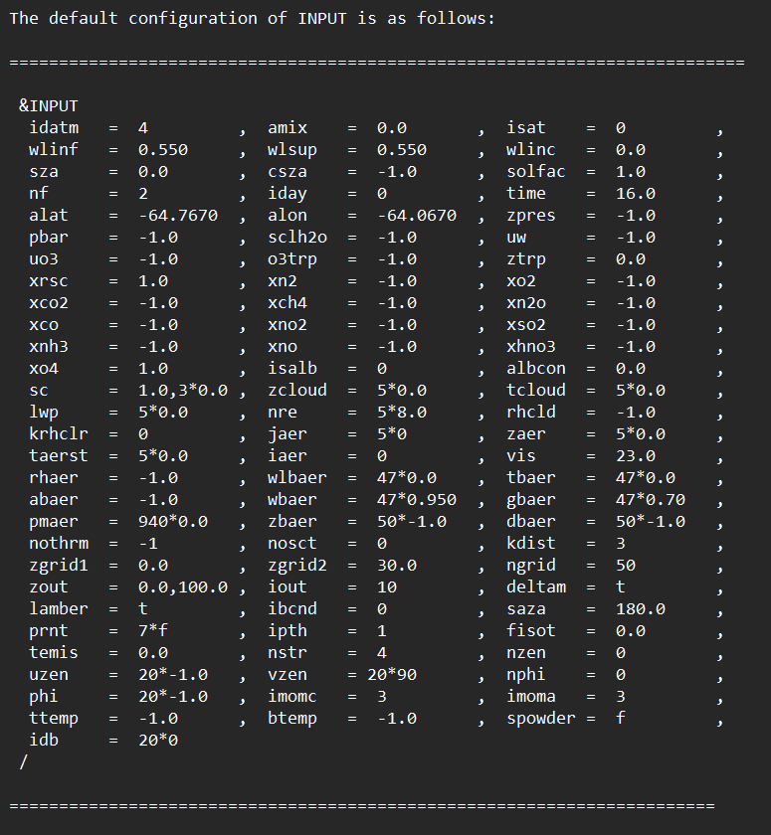
12
INPUT FILE
INPUT
The INPUT file of the program has 85 inputs, those can be categorized as:
Wavelength Limits, Filter Function Specification
Solar Geometry
Surface Reflectance Properties
Model Atmospheres
Cloud Parameters
Stratospheric Aerosols
Boundary Layer Aerosols (Bla)
Radiation Boundary Conditions
Taken: [6], [9], [10], [11], [12], [13]

Slide 13
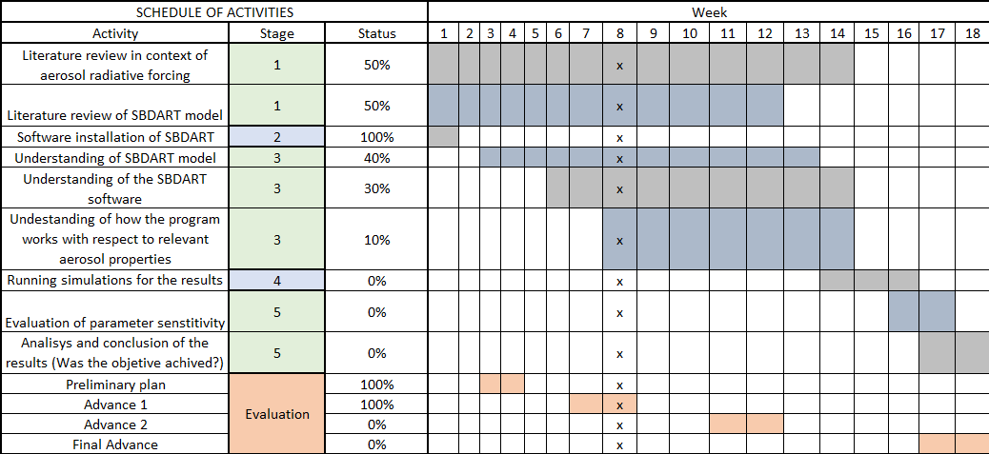
13
Schedule of activities

Slide 14
14
Next steps
Tasks
Continue to review the literature of radiative transfer and aerosol radiative forcing.
Identify all inputs of the model and their implications in the radiative transfer simulations.
Understand the units of measurement used to report properties in the literature.
Determine unit conversions of parameters in order to run simulations of RT.
Identify databases to obtain input parameters for implementing simulations of local radiative transfer.
Create an input file that accounts for local atmospheric properties.
Additional work:
Keep a record of the understanding process of the SBDART model for future developments carried out by the 4DAir programs.

Slide 15
15
References
[1] Contributors to Wikimedia projects. (2005, October 17). Radiative transfer - Wikipedia. Wikipedia, the free encyclopedia. Available: https://en.wikipedia.org/wiki/Radiative_transfer (Accessed: February 13, 2024)
[2] Contributors to Wikimedia projects. (2004, April 5). Stereoradian - Wikipedia, the free encyclopedia. Wikipedia, the free encyclopedia. https://es.wikipedia.org/wiki/Estereorradián (Accessed: February 27, 2024)
[3] Salby, M. L. (2012). Physics of the Atmosphere and Climate. Cambridge University Press.
[4] “Beer Lambert Law | Transmittance & Absorbance | Edinburgh Instruments.” Edinburgh Instruments. Accessed March 11, 2024. [Online]. Available: https://www.edinst.com/blog/the-beer-lambert-law/
[5] “[Solved] A gray body is defined such that.” Testbook. Accessed March 11, 2024. [Online]. Available: https://testbook.com/question-answer/a-gray-body-is-defined-such-that--591c22a8c1baab08c721ab0e
[6] GitHub: Let's build from here · GitHub. Accessed March 11, 2024. [Online]. Available: https://github.com/paulricchiazzi/SBDART/blob/master/Documents/rtdoc.txt
[7] UCSB Physics - Redirection Page. Accessed March 11, 2024. [Online]. Available: https://web.physics.ucsb.edu/~fratus/phys103/LN/Scattering.pdf
[8] The Abundance of Carbon Monoxide in Neptune's Atmosphere - Scientific Figure on ResearchGate. Available from: https://www.researchgate.net/figure/Setup-of-the-plane-parallel-atmosphere-used-in-calculating-the-Neptune-model_fig12_253391065 [accessed 11 Mar, 2024]
[9] "OnlineResize.club. Resize image, Crop pics, Add Instagram effect." onlineresize.club. Accessed March 14, 2024. [Online]. Available: https://onlineresize.club/2021-club.html

Slide 16
16
References
[10] "Surface albedo, artwork - Stock Image - E100/0284." Science Photo Library. Accessed March 14, 2024. [Online]. Available: https://www.sciencephoto.com/media/160631/view/surface-albedo-artwork
[11] "An educational infographic depicting the composition of Earth's atmosphere," OpenAI DALL·E, 13 Mar. 2024. [Online image]. Available: /mnt/data/An_educational_infographic_depicting_the_compositi.png
[12] "An educational infographic illustrating stratospheric aerosols in Earth's atmosphere," OpenAI DALL·E, 13 Mar. 2024. [Online image]. Available: /mnt/data/An_educational_infographic_illustrating_stratosphe.png
[13] "An infographic visualizing the radiation boundary conditions in Earth's atmosphere without any text," OpenAI DALL·E, 13 Mar. 2024. [Online image]. Available: /mnt/data/An_infographic_visualizing_the_radiation_boundary_.png

Slide 17

THANKS
Vigilada Mineducación

